Slide 1
Class Variables
Class Variables: Class variables are available across different objects. A class variable belongs to the class and is a characteristic of a class. They are preceded by the sign @@ and are followed by the variable name.
class Xyz
@@a=4
def initialize
@@a+=1
end
def p_x
p @@a
end
end
a=Xyz.new
b=Xyz.new
a.p_x =>1
b.p_x =>
class Pqr<Xyz
End
c=Pqr.new
c.p_x => 3

Slide 2
Instance Variable
Instance Variables: Instance variables are available across methods for any particular instance or object. That means that instance variables change from object to object. Instance variables are preceded by the at sign (@) followed by the variable name.
class Abc
def initialize
@a=1
end
def p_x
p @a+=1
end
end
e=Abc.new
e.p_x => 2
f=Abc.new
f.p_x =>2
class Mno<Abc
End
m=Mno.new
m.p_x =>2

Slide 3
Operator Overloading
class String
def <<(value)
self.replace(value + self)
end
end
str = "Hello, "
str << "World."
puts str
Class Fixnum
def + i
self*i
end
end
6+9

Slide 4
Accessors
attr_reader
class Abc
attr_reader :age
def initialize(c)
@age=c
end
end
Abc.new(8).age =>8
Abc.new(97).age=8
NoMethodError: undefined method `age=' for #<Abc:0x0000000191a220 @age=97>
attr_writer
class Dbc
attr_writer :age
def initialize(c)
@age=c
end
Dbc.new(8).age
NoMethodError: undefined method `age' for #<Dbc:0x00000001ad0010 @age=8>
Dbc.new(8).age=6

Slide 5
class Sbc
attr_accessor :age
def initialize(c)
@age=c
end
end
x=Sbc.new(4)
=> #<Sbc:0x00000001916918 @age=4>
x.age
=> 4
x.age=8
=> 8
x.age
=> 8
class Gbc
attr_writer :age
def age=(d)
@age=d
end
end
c=Gbc.new
c.age
=> nil
c.age=8
=> 8
c.age
=> 8

Slide 6
Private
class Abc
def initialize
end
private
def c
p "jj"
end
end
=> :c
2.3.1 :157 > Abc.new.c
NoMethodError: private method `c' called for #<Abc:0x00000001915ae0>
class Abc
def initialize
c
end
private
def c
p "jj"
end
end
Abc.new
"jj"

Slide 7
Protected
class Abc
def initialize
end
protected
def c
p "jj"
end
end
=> :c
2.3.1 :157 > Abc.new.c
NoMethodError: protected method `c' called for #<Abc:0x00000001915ae0>
class Abc
def initialize
c
end
protected
def c
p "jj"
end
end
Abc.new
"jj"
class Dcc<Abc
def initialize
c
end
end
=>Dcc.new
"jj"

Slide 8
Public
class Pub
def initialize
end
def p_x
p "hi"
end
end
=> :p_x
Pub.new.p_x
"hi"
=> "hi"
class D<Pub
end
=> nil
D.new.p_x

Slide 9
$* (Dollar Splat)
$* is basically shorthand for ARGV. $* contains the command line arguments that were passed to the script.
example.rb
puts "$*: " << $*.inspect
puts "ARGV: " << ARGV.inspect
Jims-MacBook-Pro:~/Desktop ruby example.rb hello world
$*: ["hello", "world"]
ARGV: ["hello", "world"]
$? (Dollar Question Mark)
$? returns the exit status of the last child process to finish.
>> `pwd` # Show current directory
=> "/Users/jimneath/Desktop\n"
>> $?
=> #<Process::Status: pid=17867,exited(0)>
>> `fake command` # This will fail
(irb):7: command not found: fake command
=> ""
>> $?
=> #<Process::Status: pid=17871,exited(127)>
Note: 127=> "command not found".

Slide 10
Environmental Global Variables
$: is basically a shorthand version of $LOAD_PATH. $: contains an array of paths that your script will search through when using require.
>> $: === $LOAD_PATH
=> true
>> $:
=> [".", "/Users/jimneath/.ruby"]
>> $: << '/test/path' # Add a directory to load path
=> [".", "/Users/jimneath/.ruby", "/test/path"]
$0 (Dollar Zero)
$0 contains the name of the ruby program being run. This is typically the script name.
example.rb
puts $0
Jims-MacBook-Pro:~/Desktop ruby example.rb
example.rb
Jims-MacBook-Pro:~/Desktop irb
>> $0
=> "irb"

Slide 11
$$ (Dollar Dollar)
$$ returns the process number of the program currently being ran.
Jims-MacBook-Pro:~/Desktop irb
>> $$ # Show process id
=> 17916
>> puts `ps aux | grep irb`
jimneath 17919 0.0 0.0 599780 388 s000 R+ 2:51PM 0:00.00 grep irb
jimneath 17917 0.0 0.0 600252 680 s000 S+ 2:51PM 0:00.01 sh -c ps aux | grep irb
jimneath 17916 0.0 0.6 85336 12568 s000 S+ 2:51PM 0:00.75 irb
Regular Expression Global Variables
$~ (Dollar Tilde)
$~ contains the MatchData from the previous successful pattern match.
>> "hello world".match(/world/) === $~
=> true
>> $~
=> #<MatchData:0x12be0e8>
>> $~.to_a
=> ["world"]

Slide 12
$1, $2, $3, $4 etc
$1-$9 represent the content of the previous successful pattern match.
>> "hello world".match(/(hello) (world)/)
=> #<MatchData:0x12b06f0>
>> $1
=> "hello"
>> $2
=> "world"
>> $3
=> nil
$+ (Dollar Plus)
$+ contains the last match from the previous successful pattern match.
>> "the quick brown fox".match(/(quick) (brown) (fox)/)
=> #<MatchData:0x1294a04>
>> $~.to_a
=> ["quick brown fox", "quick", "brown", "fox"]
>> $+
=> "fox"

Slide 13
Built-in Classes
Array
Bignum
Class
Dir
Exception
FalseClass
File
Fixnum
Float
Hash
Integer
IO
MatchData
Module
NilClass
Object
Proc
Range
Regexp
String
Symbol
Thread
Time
TrueClass

Slide 14
Ruby Math Functions and Methods
The Ruby Math module provides the Ruby programmer with an extensive range of methods for performing mathematical tasks. In addition, the Math module includes two commonly used mathematical constants.
Math.constants
=> ["E", "PI"]
Math::PI
=> 3.14159265358979
Math::E
=> 2.71828182845905

Slide 15
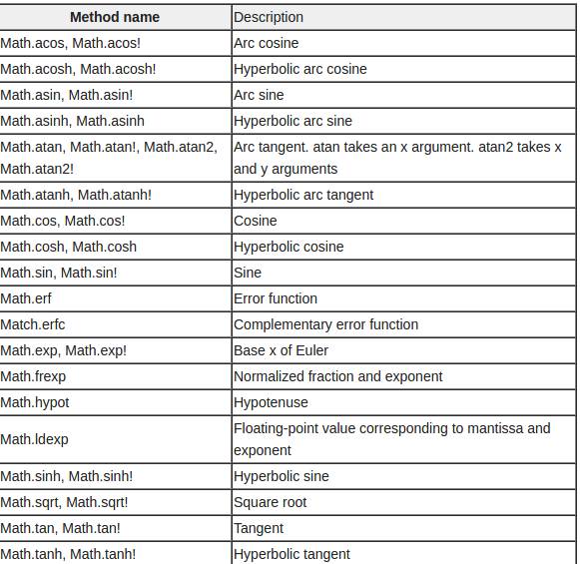
Ruby Math Methods

Slide 16
Built-in Class Hierarchy
String.ancestors # [String, Enumerable, Comparable, Object, Kernel]
Enumerable.ancestors # [Enumerable]
Comparable.ancestors # [Comparable]
Object.ancestors # [Object, Kernel]
Kernel.ancestors # [Kernel]

Slide 17
Super Keyword
When you invoke super with arguments, Ruby sends a message to the parent of the current object, asking it to invoke a method of the same name as the method invoking super. super sends exactly those arguments.
class Dog
def initialize(breed)
@breed = breed
end
end
class Lab < Dog
def initialize(breed, name)
super(breed)
@name = name
end
def to_s
"(#@breed, #@name)"
end
end
puts Lab.new("Labrador", "Benzy").to_s

Slide 18
Reading from the Standard Input
Most common method to read from stdin is gets. Without any argument, gets reads stdin until the end stream or to the newline characters. You can pass a number to it - it would be a number of characters to read, or a string - the separator
input = gets # the same as $stdin.gets - default is stdin
I can type whatever till the newline.
#=> "I can type whatever till the newline.\n"
input = gets.chomp # very useful - removes newline just after typing
This text is without newline
#=> "This text is without newline"
input = gets(10) # get only first 10 characters
This text will be limited to ten characters
#=> "This text "
gets # get the rest of the buffered stdin
#=> "will be limited to ten characters\n"
input = gets "!" # specify the separator
Can write anything, even newlines
until it reach exclamation!
#=> "Can write anything, even newlines\nuntil it reach!"

Slide 19
Reading and Writing Disk Files
The File.new Method:
You can create a File object using File.new method for reading, writing, or both, according to the mode string. Finally, you can use File.close method to close that file.
Syntax:
aFile = File.new("filename", "mode")
# ... process the file
aFile.close
The File.open Method:
You can use File.open method to create a new file object and assign that file object to a file. However, there is one difference in between File.open and File.new methods. The difference is that the File.open method can be associated with a block, whereas you cannot do the same using the File.new method.
File.open("filename", "mode") do |aFile|
# ... process the file
end
Here is a list of The Different Modes of Opening a File:

Slide 20
Modes Description
r Read-only mode. The file pointer is placed at the beginning of the file. This is the default mode.
r+ Read-write mode. The file pointer will be at the beginning of the file.
w Write-only mode. Overwrites the file if the file exists. If the file does not exist, creates a new file for writing.
w+ Read-write mode. Overwrites the existing file if the file exists. If the file does not exist, creates a new file for reading and writing.
a Write-only mode. The file pointer is at the end of the file if the file exists. That is, the file is in the append mode. If the file does not exist, it creates a new file for writing.
a+ Read and write mode. The file pointer is at the end of the file if the file exists. The file opens in the append mode. If the file does not exist, it creates a new file for reading and writing.

Slide 21
The sysread Method:
aFile = File.new("input.txt", "r")
if aFile
content = aFile.sysread(20)
puts content
else
puts "Unable to open file!"
end
The syswrite Method:
aFile = File.new("input.txt", "r+")
if aFile
aFile.syswrite("ABCDEF")
else
puts "Unable to open file!"
end

Slide 22
File.readable?( "test.txt" ) # => true
File.writable?( "test.txt" ) # => true
File.executable?( "test.txt" ) # => false
File.zero?( "test.txt" )
File.size?( "text.txt" )
File::ftype( "test.txt" ) # => file
Navigating Through Directories:
Dir.chdir("/usr/bin")
puts Dir.pwd # This will return something like /usr/bin
You can get a list of the files and directories within a specific directory using Dir.entries:
puts Dir.entries("/usr/bin").join(' ')
Creating a Directory:
Dir.mkdir("mynewdir")
You can also set permissions on a new directory (not one that already exists) with mkdir:
NOTE: The mask 755 sets permissions owner, group, world [anyone] to rwxr-xr-x where r = read, w = write, and x = execute.
Dir.mkdir( "mynewdir", 755 )

Slide 23
Deleting a Directory:
The Dir.delete can be used to delete a directory. The Dir.unlink and Dir.rmdir perform exactly the same function and are provided for convenience.
Dir.delete("testdir")

Slide 24
Renaming and Deleting Files:
# Rename a file from test1.txt to test2.txt
File.rename( "test1.txt", "test2.txt" )
File.delete("test2.txt")
File Modes and Ownership:
file = File.new( "test.txt", "w" )
file.chmod( 0755 )
File Inquiries:
File.open("file.rb") if File::exists?( "file.rb" )
# This returns either true or false
File.file?( "text.txt" )
# a directory
File::directory?( "/usr/local/bin" ) # => true
# a file
File::directory?( "file.rb" ) # => false

Slide 25
Ruby Exceptions
An exception is a special kind of object, an instance of the class Exception
it indicates that something has gone wrong.
By default, Ruby programs terminate when an exception occurs
But it is possible to declare exception handlers. An exception handler is a block of code that is executed if an exception occurs during the execution of some other block of code
Raising an exception means stopping normal execution of the program and transferring the flow-of-control to the exception handling code where you either deal with the problem that's been encountered or exit the program completely.

Slide 26
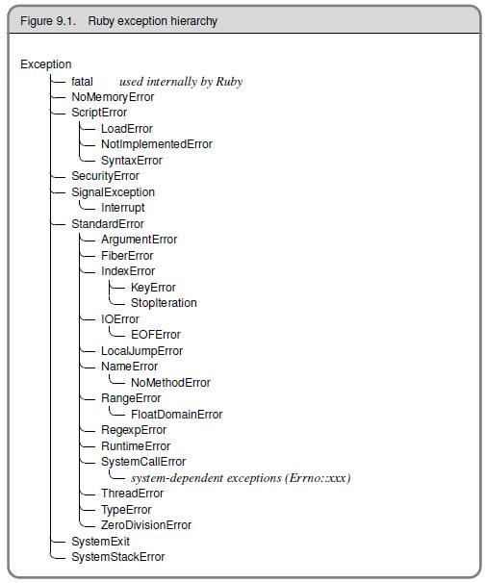

Slide 27
def raise_exception
puts 'I am before the raise.'
raise 'An error has occured'
puts 'I am after the raise'
end
raise_exception
The output is:
>I am before the raise.
RuntimeError: An error has occured
from (irb):24:in `raise_exception'
The raise method is from the Kernel module. By default, raise creates an exception of the RuntimeError class. To raise an exception of a specific class, you can pass in the class name as an argument to raise.

Slide 28
def inverse(x)
raise ArgumentError, 'Argument is not numeric' unless x.is_a? Numeric
1.0 / x
end
puts inverse(2)
puts inverse('not a number')
puts inverse(2)
0.5
=> nil
2.3.1 :033 > puts inverse('not a number')
ArgumentError: Argument is not numeric
from (irb):29:in `inverse'
from (irb):33

Slide 29
Handling an Exception
To do exception handling, we enclose the code that could raise an exception in a begin-end block and use one or more rescue clauses to tell Ruby the types of exceptions we want to handle.
def raise_and_rescue
begin
puts 'I am before the raise.'
raise 'An error has occured.'
puts 'I am after the raise.'
rescue
puts 'I am rescued.'
end
puts 'I am after the begin block.'
end
raise_and_rescue
I am before the raise.
I am rescued.
I am after the begin block.

Slide 30
You can stack rescue clauses in a begin/rescue block. Exceptions not handled by one rescue clause will trickle down to the next:
begin
# -
rescue OneTypeOfException
# -
rescue AnotherTypeOfException
# -
else
# Other exceptions
end
If you want to interrogate a rescued exception, you can map the Exception object to a variable within the rescue clause
begin
raise 'A test exception.'
rescue Exception => e
puts e.message
puts e.backtrace.inspect
end
ruby p046excpvar.rb
A test exception.

Slide 31
The Exception class defines two methods that return details about the exception. The message method returns a string that may provide human-readable details about what went wrong. The other important method is backtrace. This method returns an array of strings that represent the call stack at the point that the exception was raised.
If you need the guarantee that some processing is done at the end of a block of code, regardless of whether an exception was raised then the ensure clause can be used. ensure goes after the last rescue clause and contains a chunk of code that will always be executed as the block terminates. The ensure block will always run.
begin
raise 'A test exception.'
rescue Exception => e
puts e.message
puts e.backtrace.inspect
ensure
puts "Ensuring execution"
end

Slide 32
class Name
# Define default getter methods, but not setter methods.
attr_reader :first, :last
# When someone tries to set a first name, enforce rules about it.
def first=(first)
if first == nil or first.size == 0
raise ArgumentError.new('Everyone must have a first name.')
end
first = first.dup
first[0] = first[0].chr.capitalize
@first = first
end
# When someone tries to set a last name, enforce rules about it.
def last=(last)
if last == nil or last.size == 0
raise ArgumentError.new('Everyone must have a last name.')
end
@last = last
end
def full_name
"#{@first} #{@last}"
end
# Delegate to the setter methods instead of setting the instance
# variables directly.
def initialize(first, last)
self.first = first
self.last = last
end
end

Slide 33
jacob = Name.new('Jacob', 'Berendes')
jacob.first = 'Mary Sue'
jacob.full_name # => "Mary Sue Berendes"
john = Name.new('john', 'von Neumann')
john.full_name # => "John von Neumann"
john.first = 'john'
john.first # => "John"
john.first = nil
# ArgumentError: Everyone must have a first name.
Name.new('Kero, international football star and performance artist', nil)
# ArgumentError: Everyone must have a last name.

Slide 34
Retry
Sometimes this endpoint would fail due to bad network conditions so I wanted to retry the request a few times before marking the attempt as failed.
def publish_to_api(data={})
tries ||= 3
DataLibrary.publish(data)
rescue DataLibraryFailureException => e
retry unless (tries -= 1).zero?
else
logger.info "success!"
end

Slide 35
Creating Your Own Exceptions
Creating your own exceptions in Ruby is extremely simple, all you need to do is create a class that inherits from Exception or one of it's descendants
class MyError < StandardError
attr_reader :thing
def initialize(msg="My default message", thing="apple")
@thing = thing
super(msg)
end
end
begin
raise MyError.new("my message", "my thing")
rescue Exception=> e
puts e.thing # "my thing"
end

Slide 36
Modules
Modules are a way of grouping together methods, classes, and constants. Modules give you two major benefits:
Modules provide a namespace and prevent name clashes.
Modules implement the mixin facility.
module DogsRelated
NBR_OF_DOGS_NEEDED_TO_START_A_DOG_PARTY = 5
class Dog
def bark
puts "Woof..."
end
def eat
puts "..."
end
def wag_tail
puts "I'm doing this because I'm happy"
end
def give_the_paw
puts "Why??"
end
end
end

Slide 37
x = 6
charlie = DogsRelated::Dog.new
charlie.wag_tail if x >=DogsRelated::NBR_OF_DOGS_NEEDED_TO_START_A_DOG_PARTY

Slide 38
Ruby include Statement:
You can embed a module in a class. To embed a module in a class, you use the include statement in the class:
module Week
FIRST_DAY = "Sunday"
def Week.weeks_in_month
puts "You have four weeks in a month"
end
def Week.weeks_in_year
puts "You have 52 weeks in a year"
end
end

Slide 39
Ruby include Statement:
You can embed a module in a class. To embed a module in a class, you use the include statement in the class:

Slide 40
$LOAD_PATH << '.'
require "support"
class Decade
include Week
no_of_yrs=10
def no_of_months
puts Week::FIRST_DAY
number=10*12
puts number
end
end
d1=Decade.new
puts Week::FIRST_DAY
Week.weeks_in_month
Week.weeks_in_year
d1.no_of_months
=>
Sunday
You have four weeks in a month
You have 52 weeks in a year
Sunday
120

Slide 41
Mixins in Ruby
Ruby does not support multiple inheritance.
module A
def a1
end
end
module B
def b1
end
end
class Sample
include A
include B
def s1
end
end
samp=Sample.new
samp.a1
samp.b1
samp.s1

Slide 42
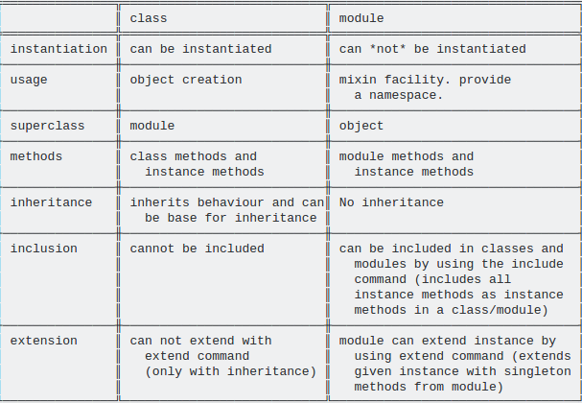
Difference b/w Class and Module

Slide 43
Ruby dynamic method calling
s= "hi man"
p s.length #=> 6
p s.include? "hi" #=> true
1) One way to invoke a method dynamically in ruby is to send a message to the object :
p s.send(:length) #=> 6
p s.send(:include?,"hi") #=> true
2) A second way is instantiate a method object and then call it:
method_object = s.method(:length)
p method_object.call #=> 6
method_object = s.method(:include?)
p method_object.call('hi') #=> true
3) And the third way is to use the eval method:
eval "s.length" #=> 6
eval "s.include? 'hi'" #=>true

Slide 44
Marshalling
The marshaling library converts collections of Ruby objects into a byte stream.
Ruby has a standard class Marshal that does all the job for serialization and deserialization.
To serialize an object, use Marshal.dump, to deserialize - Marshal.load or Marshal.restore.
marshalled = Marshal.dump([1, 2, 'string', Object.new])
# => "\x04\b[\ti\x06i\aI\"\vstring\x06:\x06ETo:\vObject\x00"
Marshal.load(marshalled)
# => [1, 2, "string", #<Object:0x00000002643000>]

Slide 45
class Klass
def initialize(str)
@str = str
end
def sayHello
@str
end
end
o = Klass.new("hello\n")
data = Marshal.dump(o)
obj = Marshal.load(data)
obj.sayHello

